Slide 1
CSCI 2400 Computer Systems
Data Lab Recitation

Slide 2
Labs: 5labs/assignment
All labs are given timeline ~ 3 weeks
Data Lab
Bomb Lab
Attack Lab
Performance Lab
Shell Lab
Please start all labs ASAP, don't wait for last week or last minute so you understand lab completely by taking CA/TA’s help.
If all students access the servers last minute server might, and you could face lot of issues and hence start soon.
Suggestion: If you taking multiple credit hours with this class it will be harder to manage and do well. Talk to your advisors about previous student’s experience taking more credit hours and dropping at the end.

Slide 3
Expectations
All the questions or doubts needs to asked in Discussion forum. TA’s will answer the same by EOD /12 PM of the same day.
Will help other students with same problem
If any other student had similar problems, they are encouraged to respond.
Emails to fix the code with attached code/ any questions regarding solving the problems will be ignored (Discussion forum is platform for that)
you are not supposed send CA/TA code and ask them to fix it. You can meet in office hours and discuss and get help to solve problems on own.
TA/CA will not give answers they only help you to reach to answer.
Any logistics issues with deadline/interview slots needs to be resolved with TA before deadline-Email communication.

Slide 4
Cheating:
It is considered very serious in this class.
Syllabus: “Students may work in teams of up to two for the labs only, but each student will still be responsible for scheduling their own grading meeting with the TA for each lab. You may help others only to the extent of answering typical questions that arise during compiling, debugging, and executing your lab assignments”
We have plagiarism tool in the moodle , this gives us report how similar each submission from rest of class and internet . So don’t cheat.
If you answer all question in grading, we don’t check your plagiarism report but if you have the submission running but cannot explain what you have done then we cross check everything.
If you have trouble explaining the labs, explain to TA in the beginning so he can ask you questions in different way. (Taking slot under you TA will help here)

Slide 5
Grading interview slots
All the slots be released a week before the submission deadline and announcement will be done in Moodle Announcement page.
Slots need to be taken before the deadline of the lab.
If you don’t get slots or cannot make it any o f them, contact your recitation TA. This needs to be resolved before your lab deadline
If you book slot and don’t show up for interview grading without any email commination, you will not get any other slots from any TA’s
If you miss it because of emergency (health,family etc) send email to TA , you will be given a new slot.
Reasons like overslept, forgot, had an appointments booked etc will not be considered.

Slide 6
Grades for the submission
You will see your grades 3 / 4 days after your interview grading in your moodle.
Make sure you cannot see the grades and contact TA’s who did your interview grading ASAP.
Take interview slots under your recitation TA, so if modification needs to be done to your grade TA can change it.
Your Recitation TA should be your point of contact for all your grade issues.

Slide 7
Lab setup:
All the labs will be done in Jupiter Hub and link is in moodle page.
https://moodle.cs.colorado.edu/course/view.php?id=1257 -> https://coding.csel.io/
Orientation video is also attached.
If you have problem accessing the Jupiter Hub, contact help@cs.colorado.edu and this will not account for your extension of deadline.

Slide 8
Let's start
Go to class page and under data lab download : datalab-handout.tar.gz
Save it into local directory.
Go to CSEL and upload same to the folder you would create using “mkdir”
Untar it using tar –xvzf datalab-handout.tar.gz and start editing bits.c
Read datalab.pdf for compilation steps and how to run. Make sure you read it completely.

Slide 9
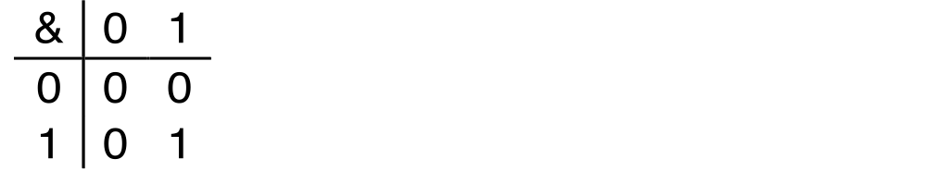
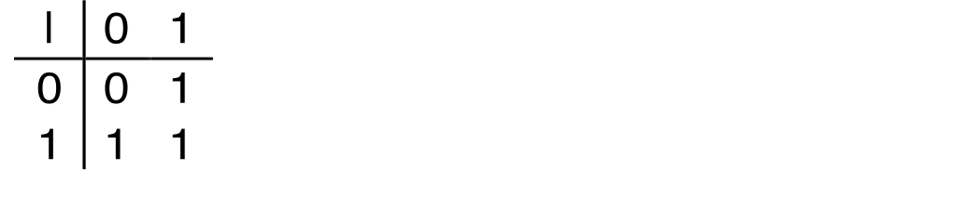
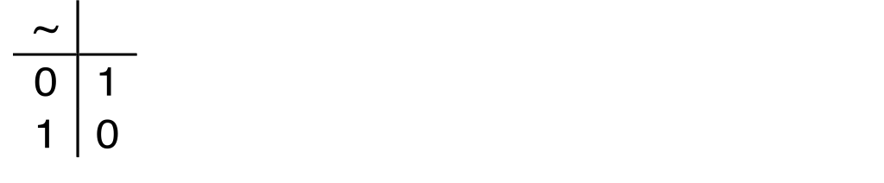
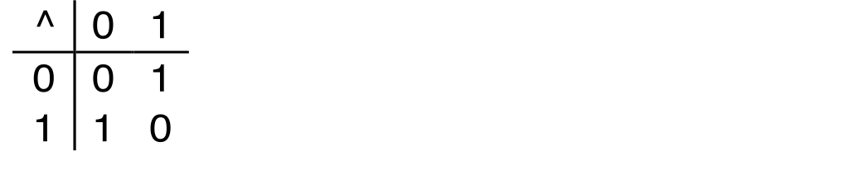
Boolean Algebra
Developed by George Boole in 19th Century Algebraic representation of logic Encode “True” as 1 and “False” as 0
And
A&B = 1 when both A=1 and B=1
Or
A|B = 1 when either A=1 or B=1
Not
~A = 1 when A=0
Exclusive-Or (Xor)
A^B = 1 when either A=1 or B=1, but not both

Slide 10
General Boolean Algebras
Operate on Bit Vectors Operations applied bitwise
All the Properties of Boolean Algebra Apply
01101001
& 01010101
01000001
01101001
| 01010101
01111101
01101001
^ 01010101
00111100
~ 01010101
10101010
01000001
01111101
00111100
10101010

Slide 11
Bit-Level Operations in C
Decimal
Hex
Binary
Operations &, |, ~, ^ Available in C
Apply to any “integral” data type
long, int, short, char, unsigned
View arguments as bit vectors
Arguments applied bit-wise
Examples (Char data type)
~0x41 → 0xBE
~010000012 → 101111102
~0x00 → 0xFF
~000000002 → 111111112
0x69 & 0x55 → 0x41
011010012 & 010101012 → 010000012
0x69 | 0x55 → 0x7D
011010012 | 010101012 → 011111012
0
0
0000
1
1
0001
2
2
0010
3
3
0011
4
4
0100
5
5
0101
6
6
0110
7
7
0111
8
8
1000
9
9
1001
A
10
1010
B
11
1011
C
12
1100
D
13
1101
E
14
1110
F
15
1111

Slide 12
Contrast: Logic Operations in C
Contrast to Bit-Level Operators
Logic Operations: &&, ||, !
View 0 as “False”
Anything nonzero as “True”
Always return 0 or 1
Early termination
Examples (char data type)
!0x41 → 0x00
!0x00 → 0x01
!!0x41→ 0x01
0x69 && 0x55 → 0x01
0x69 || 0x55 → 0x01
p && *p (avoids null pointer access)
Watch out for && vs. & (and || vs. |)…
one of the more common oopsies in
C programming

Slide 13
Shift Operations (IMPORTANT FOR DATALAB)
Argument x
01100010
Left Shift: x << y
Shift bit-vector x left y positions
Throw away extra bits on left
Fill with 0’s on right
Right Shift: x >> y
Shift bit-vector x right y positions
Throw away extra bits on right
Logical shift
Fill with 0’s on left
Arithmetic shift
Replicate most significant bit on left
Undefined Behavior
Shift amount < 0 or ≥ word size
<< 3
00010000
00010000
00010000
Log. >> 2
00011000
00011000
00011000
Arith. >> 2
00011000
00011000
00011000
Argument x
10100010
<< 3
00010000
00010000
00010000
Log. >> 2
00101000
00101000
00101000
Arith. >> 2
11101000
11101000
11101000

Slide 14
Data Lab: WriteUp.pdf
Handout instructions:
copy “datalab-handout.tar.gz” to some directory and unpack it:
tar -xvf datalab-handout.tar.gz
inside “datalab-handout” directory:
bits.c: file to write your code, total 15 functions to implement
btest.c/btest: to test the correctness of your code
dlc: to test your code for compliance with “coding rules”
“rules” are documented in bits.c
read the “rules” in bits.c before start coding
demo
Notes:
after the slide, show demo of this directory , bits.c (no dlc, no coding here)

Slide 15
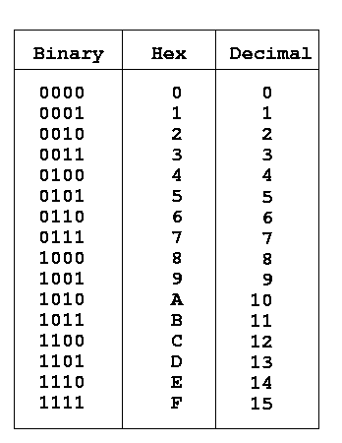
Data Lab: tips
Be careful of operator precedence
what’s the execution order of “~a+1+b*c<<3*2”?
If in confusion, use parentheses: (~a)+1+(b*(c<<3)*2)
some online tools
bitwise calculator: http://bitwisecmd.com/
hex/binary table
Notes:
any question?

Slide 16
Data Lab
I will give you guidance/hints for some of the questions
but not the solutions.
you can also try on your own, some question may have multiple solutions.
use dlc, btest to check your answer.

Slide 17
Data Lab: 1. bitAnd
* bitAnd - x&y using only ~ and | * Example: bitAnd(6, 5) = 4 * Legal ops: ~ | * Max ops: 8 * Rating: 1 */
.
Hint:
Double negation property
Ex: ~~(x|y)=~(~x & ~y)

Slide 18
Data Lab: 2. getByte
* getByte - Extract byte n from word x * Bytes numbered from 0 (LSB) to 3 (MSB) * Examples: getByte(0x12345678,1) = 0x56 * Legal ops: ! ~ & ^ | + << >> * Max ops: 6 * Rating: 2 */
Hint:
Define mask, what is mask? How to set it? Ex: if you want number to be a byte then mask is 0xff, if you want number to be 16 bits then mask is 0xffff.
0xf-> 1111 hence it should give you same number.
>> /<< should help you to get byte to a location. << means multiply and >> shift means divide. Given n is byte position. You need bits to shift.

Slide 19
Data Lab: 3. logicalShift
/* * logicalShift - shift x to the right by n, using a logical shift * Can assume that 0 <= n <= 31 * Examples: logicalShift(0x87654321,4) = 0x08765432 * Legal ops: ~ & ^ | + << >> * Max ops: 20 * Rating: 3 */
Hint: - =~+1 i.e –x=~x+1.
Right shift in c is default airthmatic right shift. Hence you would have to set the MSB n bits as zero.
Obtain the number with MSB n bits set to 0 and use it as mask.

Slide 20
Data Lab: 4. bitCount
/* * bitCount - returns count of number of 1's in word * Examples: bitCount(5) = 2, bitCount(7) = 3 * Legal ops: ! ~ & ^ | + << >> * Max ops: 40 * Rating: 4 */
Hint:
You need to count number of 1 in the given number.
Create mask of your choice and try to group the numbers. How to get 32 bit mask using 8 bit mask?
Use << and |.
Ex: you have 0x11 and you want to create 32 bit mask of same. It would be 0x11|(0x11<<24)|(0x11<<16)|(0x11<<8). Now you can use this to compute the bits.
Notes:
Use 0xAA as a mask and keep shifting the mask to get the 32bit word do an OR with x and think of how to return 1 or 0 from there based on what x is. Count the bits from right to left.

Slide 21
Data Lab: 5. bang
/* * bang - Compute !x without using ! * Examples: bang(3) = 0, bang(0) = 1 * Legal ops: ~ & ^ | + << >> * Max ops: 12 * Rating: 4 */
! Means return true if given number is
Only clue you need here is that 0 is only number whose sign bits for both positive and negative number is same.
Notes:
Similar to the previous sum catch is this for “any” OddBit.

Slide 22
Data Lab:6 tmin
/* * tmin - return minimum two's complement integer * Legal ops: ! ~ & ^ | + << >> * Max ops: 4 * Rating: 1 */
Hint:
Very easy problem. In 32 bit number system least number is -2 (pow) 31.

Slide 23
Data Lab: 7 fitBits
/* * fitsBits - return 1 if x can be represented as an * n-bit, two's complement integer. * 1 <= n <= 32 * Examples: fitsBits(5,3) = 0, fitsBits(-4,3) = 1 * Legal ops: ! ~ & ^ | + << >> * Max ops: 15 * Rating: 2 */
Hint:
Obtain the given n bits from the x using shift operators and set rest bits to zero.
You must use ^ to check if any two numbers are same or not.

Slide 24
Data Lab: 8 divpwr2
/* * divpwr2 - Compute x/(2^n), for 0 <= n <= 30 * Round toward zero * Examples: divpwr2(15,1) = 7, divpwr2(-33,4) = -2 * Legal ops: ! ~ & ^ | + << >> * Max ops: 15 * Rating: 2 */
Hint:
Division means right shift
Since you must round to zero, you must create a bias and this bias is based on if x<0 or x>0.

Slide 25
Data Lab: 9 negate
/* * negate - return -x * Example: negate(1) = -1. * Legal ops: ! ~ & ^ | + << >> * Max ops: 5 * Rating: 2 */ Hint: Very easy problem
-x=~x+1

Slide 26
Data Lab: 10 isPositive
/* * isPositive - return 1 if x > 0, return 0 otherwise * Example: isPositive(-1) = 0. * Legal ops: ! ~ & ^ | + << >> * Max ops: 8 * Rating: 3 */
Hint:
You just have to check if MSB bit is zero or one.

Slide 27
Data Lab: 11 isLessOrEqual
/* * isLessOrEqual - if x <= y then return 1, else return 0 * Example: isLessOrEqual(4,5) = 1. * Legal ops: ! ~ & ^ | + << >> * Max ops: 24 * Rating: 3 */
Hint: You should observe the MSB sign bit and then take decision based on if both numbers are positive or negative.

Slide 28
Extra credit
Try to solve by yourself
Contact TA during office hours.
Usually extra credits should be solved by students with self interest and taking help

Slide 29
Thank you

